Slide 1
Concurrent and Parallel Systems Return values from threads
Dr Sergio Davies <sergio.davies@shu.ac.uk>
Department of computing
Sheffield Hallam University
7 October 2022
Notes:
So far we have seen how threads can be spawn passing some parameters to the executed function and terminated. However we did not give any indication on how to return a value to the main function at the end of the execution of a thread.
This is what we are going to talk about in this lecture

Slide 2
Teaching schedule
LECTURES |  | LABS
Date | Topic | Date | Topic
30 Sep | Introduction to concurrency Introduction to threads in C++ Mutex variables | 27 Sep | Practical example of parallel computing Simple matrix multiplication
7 Oct | Time analysis in multithreaded software Return values from threads | 4 Oct | Multithreaded matrix multiplication – 2 approaches
14 Oct | Condition Variables | 11 Oct | Evaluation of multi-threading speed-up
21 Oct | Concurrency patterns Producer/consumer | 18 Oct | std::async / std::future / std::promise experiments Dining philosophers problem
28 Oct | Thread pooling Thread prioritisation – R/W Locks | 25 Oct | Producer/consumer pattern – unidirectional and bidirectional communications
4 Nov | Coursework support | 1 Nov | Coursework support
11 Nov | Coursework support | 8 Nov | Coursework support

Slide 3
Topics
Last week: Definition of speedup, Amdhal’s law and time measurements
Today:
Return values from threads
Asynchronous function
Future and promise variables
Notes:
Last time we disucssed about speedup and Amdhal’s law.
This time we cover how to return values from threads using asynchronous function of future and promise variables

Slide 4
Threads
Spawning a function as an independent thread:
This does not allow return values
This would not be possible: no indication of when a thread would complete (it is an asynchronous call)
Alternative: standard function call
So far, the only way to collect a result from a thread is to pass a pointer which will be filled with the return data by the thread
Need to wait for thread to complete (synchronisation) before retrieving value
template <class Fn, class... Args>
explicit thread (Fn&& fn, Args&&... args);
Notes:
We saw the method used to spawn a new thread, using the std::thread variable. This method does not allow return values: it is an asynchronous call that terminates when the thread terminates. There isn’t necessarily another thread that is waiting for the termination: this would be a synchronous call, which could be easily achieved with a simple funciton call.
However, there are cases in which it may be relevant to return a value from the thread. So far the only possible way to do this is to use a global variable to pass the value before the thread terminates. There needs to be some form of synchronisation before the receiver of the return value can read the value form the thread.

Slide 5
Problem highlights
Returning a value between two threads requires waiting for one thread to compute the value (e.g. complete execution);
But a return value is an object known at a determined time (i.e. when a function completes);
Can we merge these two concepts?
Notes:
If we want to return a value between two threads, one thread needs to wait for the other to complete the execution.
However, a return value is only known at one specific time when a function completes
Can we base the return value form a thread on these two concepts?

Slide 6
Possible solutions
Using an std::async threads with an std::future return variable;
Thread using std::promise parameter returning a value through an std::future variable
“There can be only one [future]!”
“We need to go back to the future!”
Notes:
There are two possible solutions:
The first one is to use an asynchronous thread, using the std::async variable, together with an std::future variable to store the return value
The second is to use an std::promise parameter returning a value through an std::future variable
It is important to note that there can only be one future variable for each instance: this variable cannot be copied on another variable
Let’s analyse these two possible solutions one at a time

Slide 7
Solution 1 – “Future” object
“Future” objects: “an object that can retrieve a value from some provider object or function, properly synchronizing this access if in different threads.”;
The thread function returns the object “future” at a known time, so that the two threads can continue execution independently.
When the value is required, a special function on the “future” object waits for the thread execution to complete (i.e. synchronise) when retrieving the value
Notes:
The first solution is to use a future object. This is an abject that can retrieve a value from some provider object or function, properly synchronising this access if they belong to different threads.
The thread function returns the object std::future at a known time, so that the two threads can continue the execution independently.
When the value is required, a special function on the std::future object waits for the thread execution to complete when the value is required

Slide 8
Running functions asynchronously – std::async
A different way of starting a thread:
Calls fn (with args as arguments) at some point (i.e. asynchronously), and returning without waiting for the execution of fn to complete.
template <class Fn, class... Args>
future<typename result_of<Fn(Args...)>::type>
async (Fn&& fn, Args&&... args)
Notes:
The std::async is very similar to the std::thread, the first parameter of the call i sthe function to execute, with all the other parameters being the argument to that function call.
This behaves similarly to the standard std::thread, only that there is a return value of type std::future.
The method calls the required function at some point and returning without waiting for the execution of fn to complete.

Slide 9
Example code
bool is_prime (int x)
{
std::cout << "Calculating. Please, wait...\n“;
for (int i=2; i<x; ++i)
if (x%i==0) return false;
return true;
}
Notes:
This is a simple function that returns true if the parameter is a prime number, or false otherwise.
This is done in a very stupid way by checking the modulus of the division by any number smaller that the one given.
It is not the most efficient way, but for the purpose of this example it will do the job.
Please note that there is a printout as first command of this function to show when the execution is started. Very important to note, because we will draw some conclusions based on this

Slide 10
Example code
int main () {
std::future<bool> fut = std::async (is_prime, 313222313);
std::cout << "Checking whether 313222313 is prime.\n";
std::cout << “Here main thread sleeps for 1 sec\n";
Sleep(1000);
std::cout << “Then gets the result of the function\n";
bool ret = fut.get(); // waits for is_prime to return
if (ret) std::cout << "It is prime!\n";
else std::cout << "It is not prime.\n";
return 0;}
Notes:
And this is the main function
The first line instantiates the future variable «fut» as result of the asynchronous execution of the function is_prime that we saw before with a large number as parameter.
Then a few printouts, and the value is then retrieved from the future object.
The result is then printed.
Again, very important to note that there is a sleep command between the initial printouts. This is important to note as, in combination with the printout from the is_prime function, will help us to draw some conclusions on when the function is actually executed.

Slide 11
Run example – ex10
Sequence of events
Notes:
Let’s run example ex10 and analyse the output to understand the sequence of events in the software thanks to those printouts

Slide 12
Eager vs lazy execution
std::async spawns internally a new thread, and returns a value.
The new thread can be executed:
(Lazy execution) – When the result of the function is needed from the main thread. Indicated with policy std::launch::deferred
(Eager execution) – As soon as possible. Indicated with policy std::launch::async
(Follow system standard) – Automatic. Indicated with a combination of the two policies: std::launch::async | std::launch::deferred
template <class Fn, class... Args>
future<typename result_of<Fn(Args...)>::type>
async (launch policy, Fn&& fn, Args&&... args)
Notes:
In the example what we saw was that the asynchronous execution of the is_prime function was deferred to the moment the return value was needed.
But let’s move one step at a time. Internally, the object std::async spawns a new thread that executes the function.
The new thread can be executed when the std::async object is instantiated, and this policy is called eager execution.
In alternative, the new thread can be executed only when the return value is needed, and that is called the lazy execution: defer the execution of the thread to the latest possible moment.
The system allows also an automatic or predefined execution method, either eager or lazy execution, which can be obtained using the combination of the two flags

Slide 13
Run example – ex11
Sequence of events
Notes:
Let’s run example ex11 and analyse the output to understand the sequence of events in the software with a different type of execution policy

Slide 14
Solution 2 – “Promise” object
“Promise” is an object that can store a value of type T (template) to be retrieved by a “future” object (possibly in another thread), offering a synchronization point.
The promise object is the asynchronous provider and is expected to set a value for the shared state at some point.
The future object is an asynchronous return object that can retrieve the value of the shared state, waiting for it to be ready, if necessary.
Notes:
The second method of returning a value from the thread to the main is to use a std::promise object.
This is an object that can store avalue of type T to be retrieved by a future object, offering a synchronisation point.
The promise object is the asynchronous provider and is expected to set a value for the shared state at some point of the execution. It’s a promise that the thread is going to provide a return value sooner or later. The execution will not be able to proceed without that value.
The future object is used to retrieve the promised object, waiting for it to be ready, if necessary.

Slide 15
Example code
void is_prime (int x, std::promise<bool> && prom) {
std::cout << "Calculating. Please, wait...\n";
for (int i=2; i<x; ++i)
if (x%i==0)
{
prom.set_value(false);
return;
}
prom.set_value(true); }
Notes:
To use the promise object, the signature of the function is_prime needs to change slightly. In fact, there is no return parameter to the function call, but there is an additional parameter is the function call, which is the promise object.
Very important to notice that the promise object is moved within the scope of this function with the double ampersand operator in the function prototype. This is because there can be only one promise object: it cannot be copied.
The function has similar behaviour to what we saw before, only now instead of returning the value with the return command, as we did for the async object, in this case we set the promise object just before returning form the function all. This may be done either with a true or false value, depending on the path of execution.
This set_value on the promise object triggers theside in the main which needs to receive this value.

Slide 16
Example code
int main () {
std::promise<bool> prom; std::future<bool> fut = prom.get_future();
std::thread t(is_prime, 313222313, std::move(prom));
std::cout << "Checking whether 313222313 is prime.\n";
std::cout << “Here main thread sleeps for 1 sec\n";
Sleep(1000);
std::cout << “Then gets the result of the function\n";
bool ret = fut.get();
if (ret) std::cout << "It is prime!\n";
else std::cout << "It is not prime.\n";
t.join(); return 0; }
Notes:
Indeed, let’s see the main function how changes with the use of the promise object.
In the first line the promise object is instantiated and a future object is created linked to the promise object, by using the get_future function.
After this, when the promise object is set, the future object will be able to receive the value.
Then the thread is created to launch the execution of the is_prine function we just saw in the previous slide.
Remember that the promise object is moved to the calling function, even though it will still be linked to the std::future object we set up earlier.
Then the printout and the sleep calls remain the same
When we need the return value of the thread, we use the get function call on the future object. When we do this, we ask that the main thread synchronises with the thread to receive the return value.
However, this does not join the thread. In fact, after the printout of the return value, the thread is joined in the last line, just before terminating the execution.

Slide 17
Run example – ex12
Notes:
Let’s see how this excutes in the example ex12

Slide 18
RESULTS: Time analysis on matrix multiplication software
Notes:
And this is the example of the result of the time analysis

Slide 19
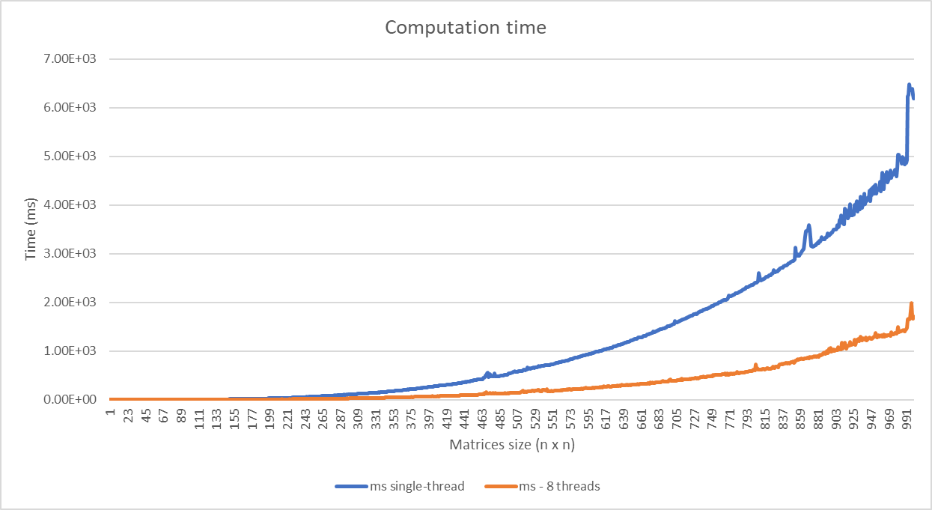
Results of timing exercise – computation time
Notes:
You can see that on the horizontal axis there is the matrix size in number of rows and number of columns. These are square matrices.
On the vertical axis there is the computational time elapsed for the specific matrix size, averaged over a number of iterations.
I run it with a single thread, blue line, and with 8 threads, orange line.
You can see the difference in execution speed that is present

Slide 20
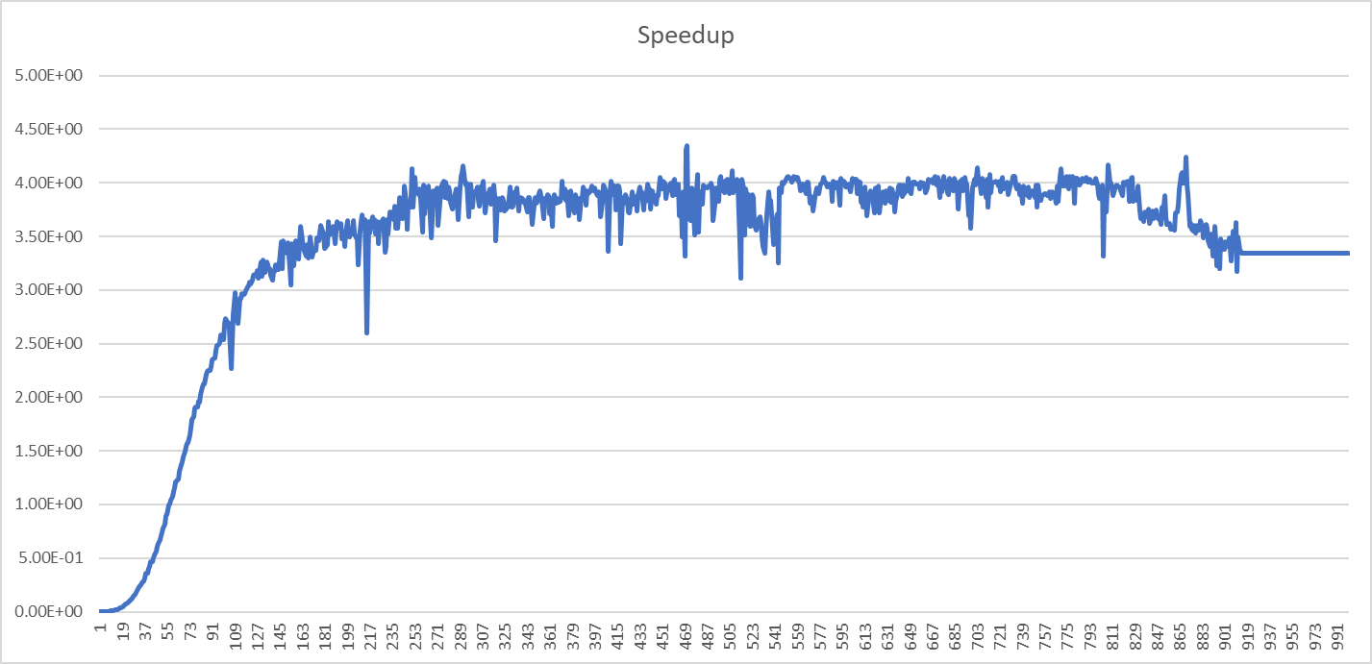
Results of timing exercise – speedup
Notes:
If we evaluate the ration between the two lines, you notice that the speedup goes rather quickly to a saturation value of 4, approximately, even though I have set up the software for running 8 threads.
This is because my CPU only has 4 cores, and it could not execute more threads in parallel.
So the additional threads only contributed some of the noise you can see at the top, through the swap in and swap out of concurrent threads

Slide 21
TUTORIAL: Returning values from threads
Notes:
Last time you needed to work on the time analysis of the matrix multiplication software.
Since the time analysis often requires longer to complete all the experiments, you can complete the timing measurement exercise in this session, and then move to the second part.

Slide 22
Tutorial session
For those who prefer to experiment:
Use any of these method of returning values from threads using both the std::async and std::future/std::promise in the threaded version of the matrix multiplication software.
Each thread returns one portion of the result matrix, which is then assembled in the main thread;
On Wednesday I will go through some examples
Notes:
In this session you will need to complete that work, and when you complete you can look at the methods of returning a value from the thread.
Use the simple multithreaded version of the softwareand modify it so that each thread returns one portion of the result matrix, which is the assembles in the main thread

